Slide 1

junkSort.AI
Juliette Lavoie, Isabella Nikolaidis, Julie Tseng June 2017
Notes:
Hi everyone, I’m Julie, this is Juliette, and this is Isabella. Thanks for coming today to our presentation, we hope you enjoy it!

Slide 2



2020 Goal
2014 Reality
70%
60%
Notes:
Add citation that this is from the sustainable development plan
Montreal Community Sustainable Development Plan has included a goal of increasing percentage of households that recycle and compost.
2014 → 58.3% recycle, goal 70% (2020) 2014 → 14% organics, goal 60% (2020)
Can help!

Slide 3
2020 Goal
2014 Reality
70%
58.3%
60%
14%
Notes:
Add citation that this is from the sustainable development plan
Montreal Community Sustainable Development Plan has included a goal of increasing percentage of households that recycle and compost.
2014 → 58.3% recycle, goal 70% (2020) 2014 → 14% organics, goal 60% (2020)
Can help!

Slide 4
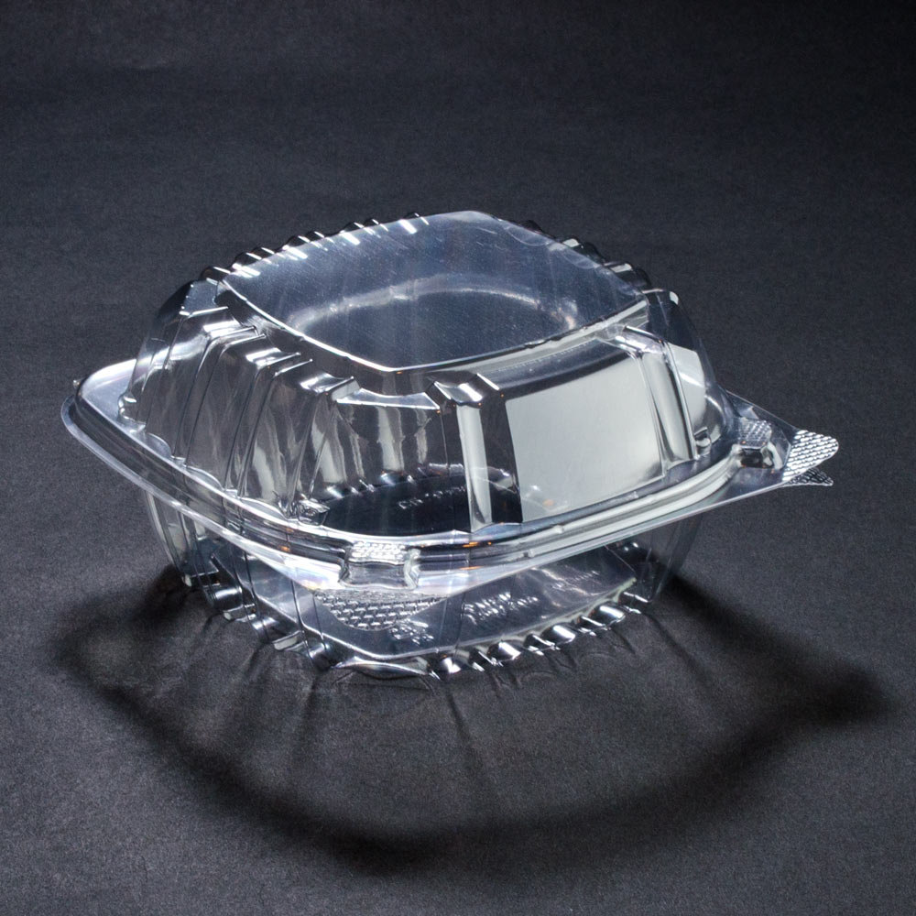

Notes:
Montreal Community Sustainable Development Plan has included a goal of increasing percentage of households that recycle and compost.
2014 → 58.3% recycle, goal 70% (2020) 2014 → 14% organics, goal 60% (2020)
Can help!

Slide 5
Mission of junkSort.AI
To aid in the categorization of materials as compostable, recyclable, or waste through computer vision.
To educate individuals about and facilitate sustainable practices.

Slide 6
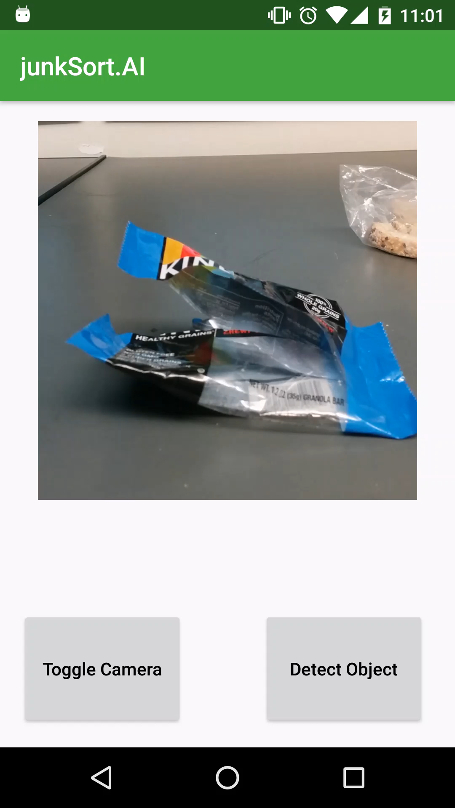
Demo
Notes:
Say the different step of training ( only paper and cardboard)

Slide 7


Process
1
Select pre-trained model
Inception V3 ( )
Notes:
Say the different step of training ( only paper and cardboard)

Slide 8

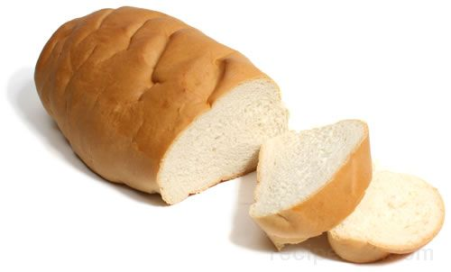
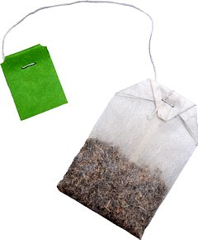

Process
1
Select pre-trained model
Inception V3 ( )
2
Retrain last layer with desired labels
Notes:
Say the different step of training ( only paper and cardboard)

Slide 9

Process
1
Select pre-trained model
Inception V3 ( )
2
Retrain last layer with desired labels
3
Classify labels into categories
Notes:
Say the different step of training ( only paper and cardboard)

Slide 10

Process
1
Select pre-trained model
Inception V3 ( )
2
Retrain last layer with desired labels
3
Classify labels into categories
4
Develop Android application
Notes:
Say the different step of training ( only paper and cardboard)

Slide 11




Potential Improvements
Customizability
User feedback
Train on more labels
Use Inception V5

Slide 12

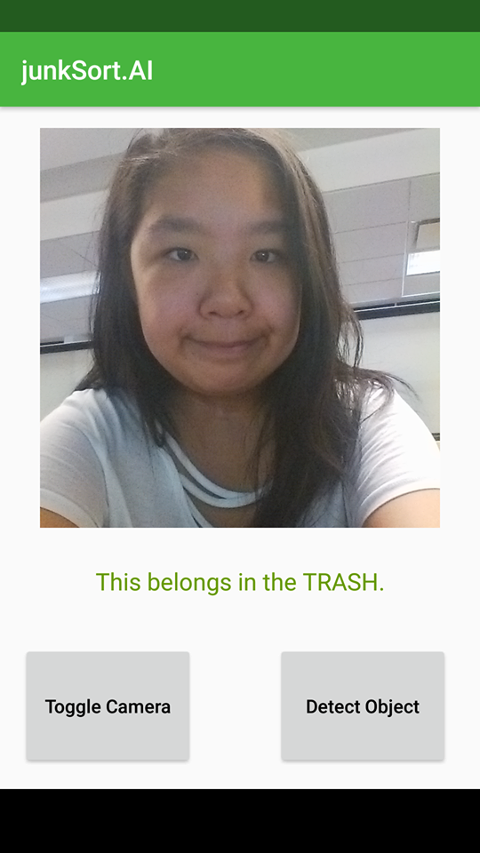
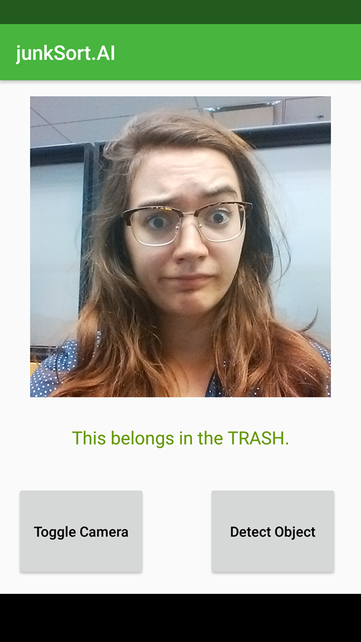
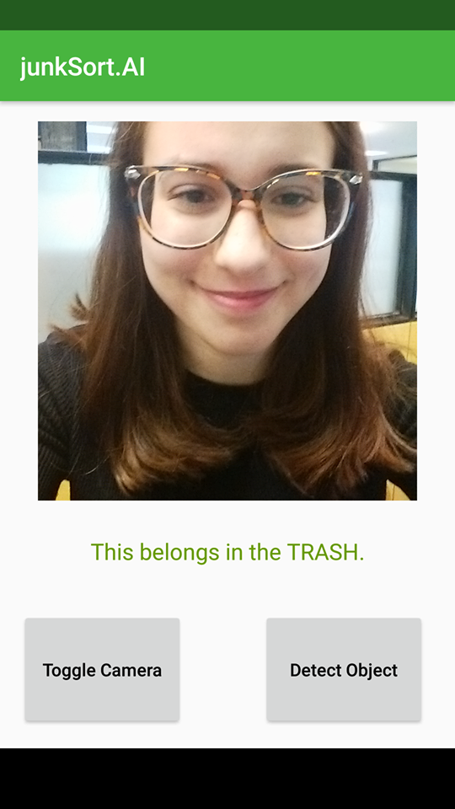
Project GitHub:
/j-tseng/junkSort.AI
Julie Tseng
Queen’s University
Math & Engineering
Juliette Lavoie
McGill University
Physics
Isabella Nikolaidis
McGill University
Linguistics
Notes:
Team slide

